Slide 1
British Airways Task-2 Presentation

Slide 2
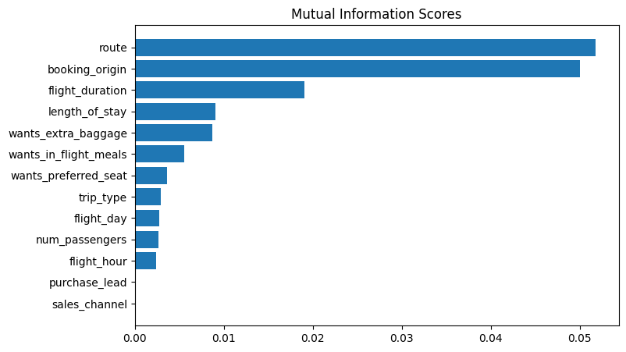
Review Analysis

Slide 3
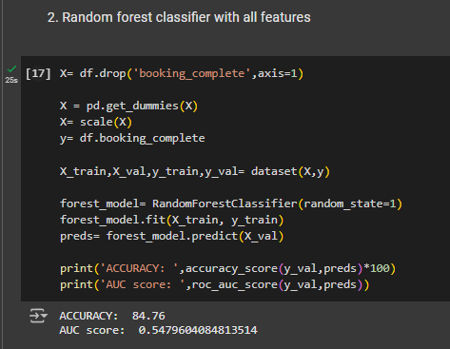
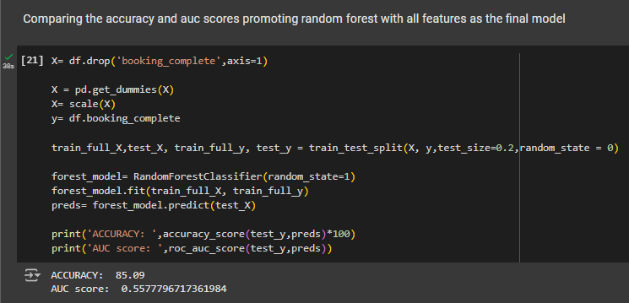
Model Analysis

